Slide 1
Advanced Thermal Runaway Detection and Delay System for EV Batteries Using Multi Sensor Integration
Team Members
Linto Thomas
Sai Vijay Shankar

Slide 2
EV’s and Future Transport
Emerging future ev trend worldwide
EV battery explosion
Environmental impacts
What can be done?

Slide 3
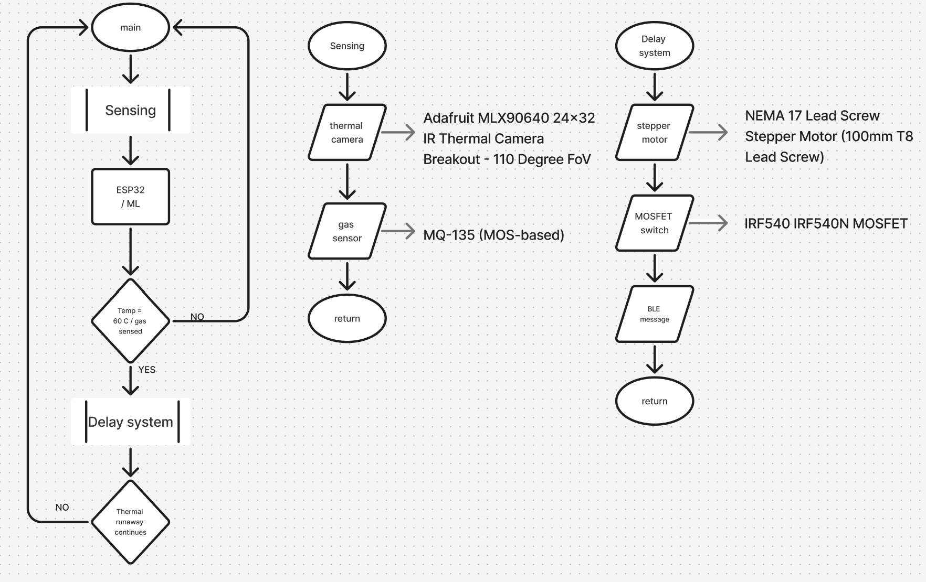
BLOCK DIAGRAM

Slide 4
HARDWARE SELECTION
Components
ESP32 microcontroller
Thermal camera-Adafruit MLX90640 24x32 IR Thermal Camera Breakout - 110 Degree FoV
MQ-135 Gas Sensor
STEPPERONLINE Nema 17 Stepper Motor
MOSFET Switch (IRF540N)

Slide 5
Power Consumption Analysis
ESP32 - 80–240 mA (active mode)
Thermal camera - 80 mW
Gas sensor - 150 mA at 5V
Stepper motor - 500 mA – 1 A
A 5V rechargeable battery is used to supply power to all components

Slide 6
Communication and Data Flow
Since we use Bluetooth connectivity we can send up to 31 bytes without connecting to any device as an advertisement for range from 50 to 100 meters
A warning message is sent only abnormality is detected

Slide 7
System Integration Challenges and Solutions
Simulation and testing
PCB layout
Machine Learning - Support Vector Machine (SVM)
Prototype to actual ev integration model limitations

Slide 8
THANK YOU

